Slide 1

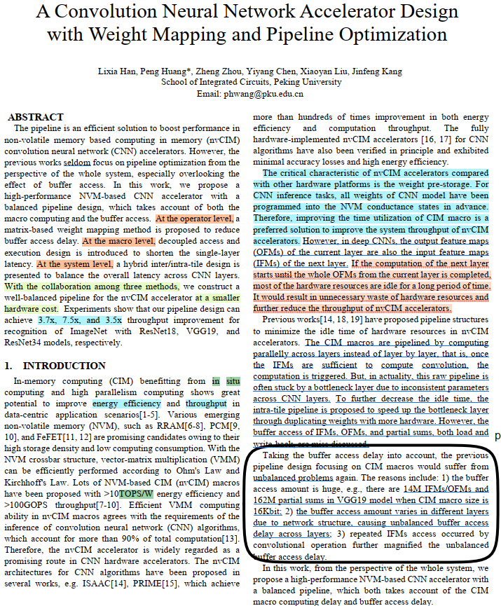
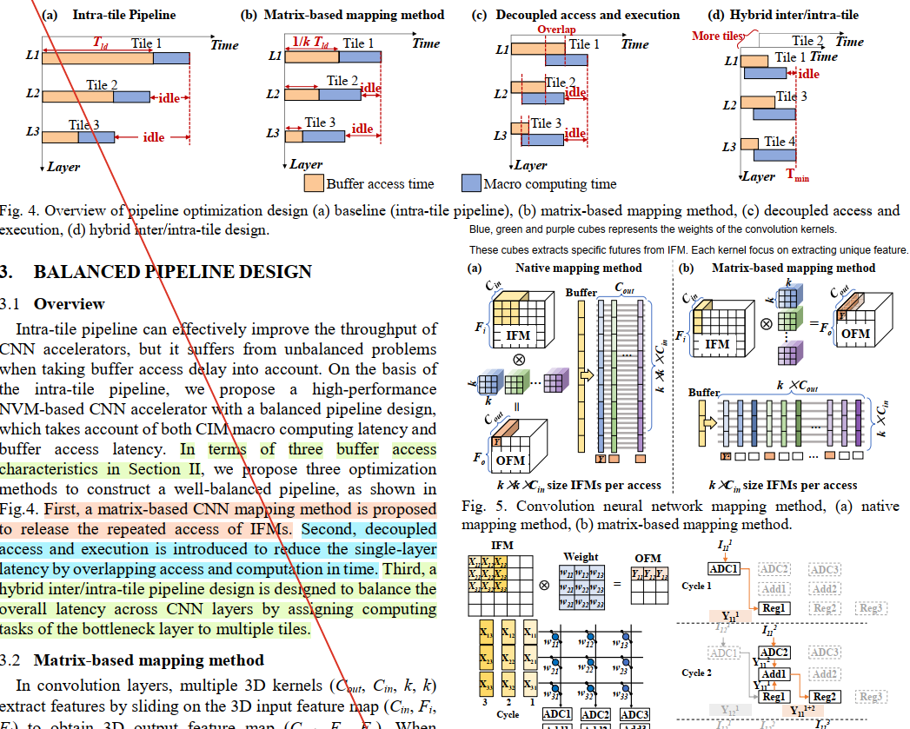
A Convolution Neural Network Accelerator Design
With Weight Mapping and Pipeline Optimization
DAC - 2023
AI Accelerators
NVM-Based CIM
Matrix-Based Mapping
Optimized Pipeline
CMP 634 – Computer Architecture
Evaluation
Kürşat Çakal
Notes:
Hi my name Kürşat,
This presentation will be about a CNN Accelerator Archtiecture.

Slide 2
Problem
CNNs dominate modern AI applications, require intensive computation and memory usage (power, energy)
AI Accelerator is a specialized computer system; which targets to optimize computation and memory needs
Cloud Computing (TPU, NPU, GPU)
Internet of Things
Sensor-Driven Tasks
Robotics
Major problem is the Latency and Efficiency of current CNN Accelerators
The buffer access amount is huge (14M IFMs/OFMs and 162M partial sums, VGG19 for CIM is 16Kbit)
Repeated IFM (Input Feature Map) access by convolution operations cause buffer delays
Computational and memory demands varias for different layers
Different for Shallow and Deep Layers in a CNN.
Notes:
Modern AI applications dominated by CNN. It requires intensive computation and memory usage.
AI Accelerators are specialized computers systems which design to handle these intensive computations and memory needs.
The major problem is latency and efficiency in the current proposed accelerator designs.
More specifically buffer access amount is huge and buffer access amount varias through different layers. Also, repeated IFM Access by convolution operations cause buffers delays.
This makes proposed designs inconvenient even if they offer attractive results in theoratically.

Slide 3
Literature Review
Efficient VMM ability in nvCIM macros agrees with the requirements of the (CNN) algorithms.
Therefore, the nvCIM accelerator is widely regarded as a promising route in CNN hardware accelerators.
ISAAC ([14]): (422 Cite Paper, 43 Cite Patent, 20000+ Read, 2016)
Introduced raw pipelines for layer-parallel computation.
Achieved >10× – 14× throughput improvement but faced idle resources in deeper layers.
PRIME ([15]): (1825 Cite Paper, 23 Cite Patent, 20000+ Read, 2016)
Achieved >100 TOPS throughput for nvCIM.
Struggles with layer imbalances and static pipelines.
Fully Hardware Implemented CNN Algorihms ([16, 17]): (1396 Cite 77000+ Access, 369 Cite, 97000+ Access)
Verified in principles and exhibited high energy efficiency by accuracy loses.
Intra-Tile Pipelines ([18, 19]): (70 Cite + 132 Cite, 10000 Read+)
Divided layers into tile, focused only on intra-layer balance, ignoring inter-layer bottlenecks.
Notes:
Non-Volatile Memory based Computing in Memory accelerators introduce promising results.
ISAAC, in-situ accelarator, proposas a raw pipeline for layer parallel computation and achieves important throughput improvement.
PRIME, novel in memory computing architecture, achieves 100 TOPS but sturuggeles with layer imbalances.
Another hardware implemented CNN algorithms suffers from accuracy loses as well as energy efficiency.
And some other studies ignores the inter-layer bottlenecks.

Slide 4
Literature Review
Existing nvCIM pipeline designs face critical challenges:
Layer-Level Bottlenecks: shallow layers often stucks and take longer to process large IFMs, over deep layers.
Hardware Utilization: Raw/Intra-tile Pipelines leave hardware resources idle in deeper layers due to their lower memory and computational demands.
Inconsistent Layer Demands: The previous pipelines optimizes a single layer, but does not handle imbalances across layers. Varying parameters across CNN cause imbalances which reduce throughput and scalability.
CNN Operational Characteristics are miss-discussed which caused by buffer access of IFM/OFM, partial sums, load/writeback.
Authors address the imbalanced hardware utilization in previous methods and propose systematic approach.
Notes:
As a summary of literature studies, they suffers from some critical challanges.
First is layer-level bottlenecks due to the shallow layers.
Second is underutilization of hardware, facing with memory and computational wastes by idle cases in deep layers.
Third is neglecting the layer demands, previous studies focus on optimizing a single layer but does not consider about the imbalances across layers.
So, we can say that CNN operational characteristics are miss-discussed and neglected.
According to the authors previous studies ignores the effect of buffer Access from the perspective of whole systems.

Slide 5
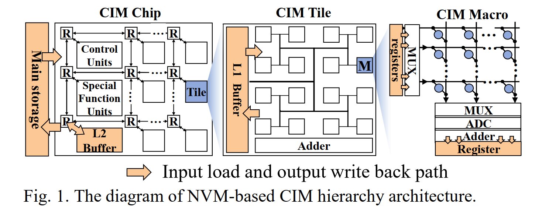
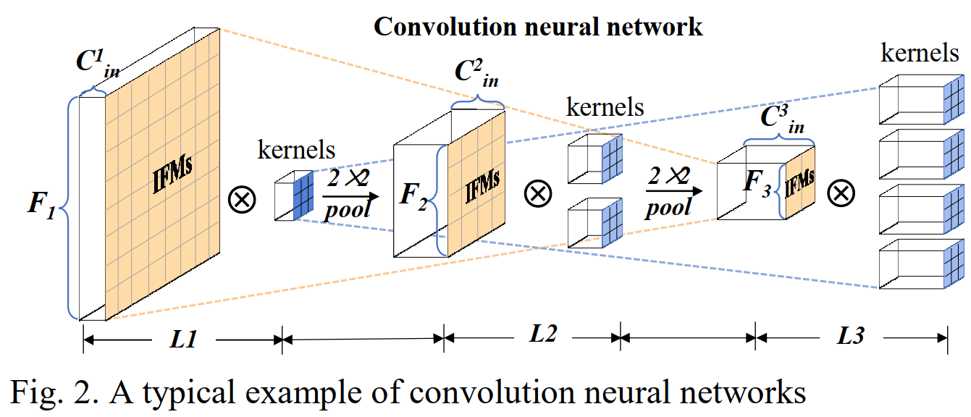
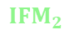
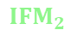
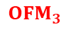
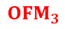
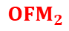
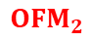


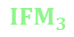
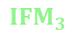
Overview
NVM-Based CIM Diagram
Training
Data
Weights
Final
Model
Complex
Deep
Features
Typical CNN
$${OFM}_{1}$$
$${IFM}_{2}$$
$${OFM}_{2}$$
$${IFM}_{3}$$
$${OFM}_{3}$$
Layer 1
$${OFM}_{1}$$
$${IFM}_{2}$$
$${OFM}_{2}$$
$${IFM}_{3}$$
$${OFM}_{3}$$
Layer 2
Layer 3
Multiple Convolution
Operations
Repeated access
BA is limited bandwidth (SAE)
BA delay varias → Layers
kernel and IFM size
channel dimension
Layer 1
Layer 2
Layer 3
Notes:
Tiles are modular computational unit in our chips, they consists multiple CIM Macro which lets us to realize computations where data is stored.
This figure illustrates the NVM-Based CIM Diagram, training data inputs flow from storage to computation units.
Data Load → from L1 Buffer in Tile → CIM Macro
Buffer access characteristics of CNN accelerators tells us about
First, Each IFM Windows convoluted multiple times, needs to be accessed repeatedly
Second, Buffer Access delay is Limited by Bandwidth, high proportion of total latency comes from here.
Third, Buffer Access delay is varias across layers. IFM Size, Channel Dimension and Kernel Size
During convolution operations, preloaded weights into crosbars arrays during initialization phase are used and remain fixed. (the weights are stored in conductance states in advance)
IFMs are successively loaded from the L2 buffer, L1 buffer, calculations done over crossbars, outputs to registers and then sent back to L1 buffers.
Complex deep features extracted from data as a Final Model.
We will see in this study how the authors handled and examined important points between two architecture and propose an accelarator architecture

Slide 6
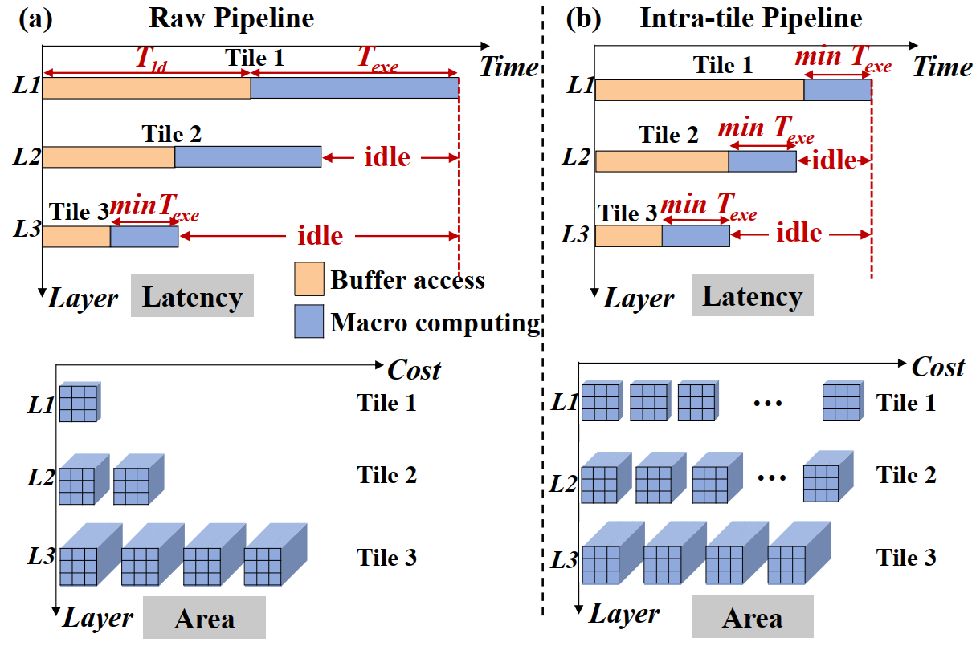
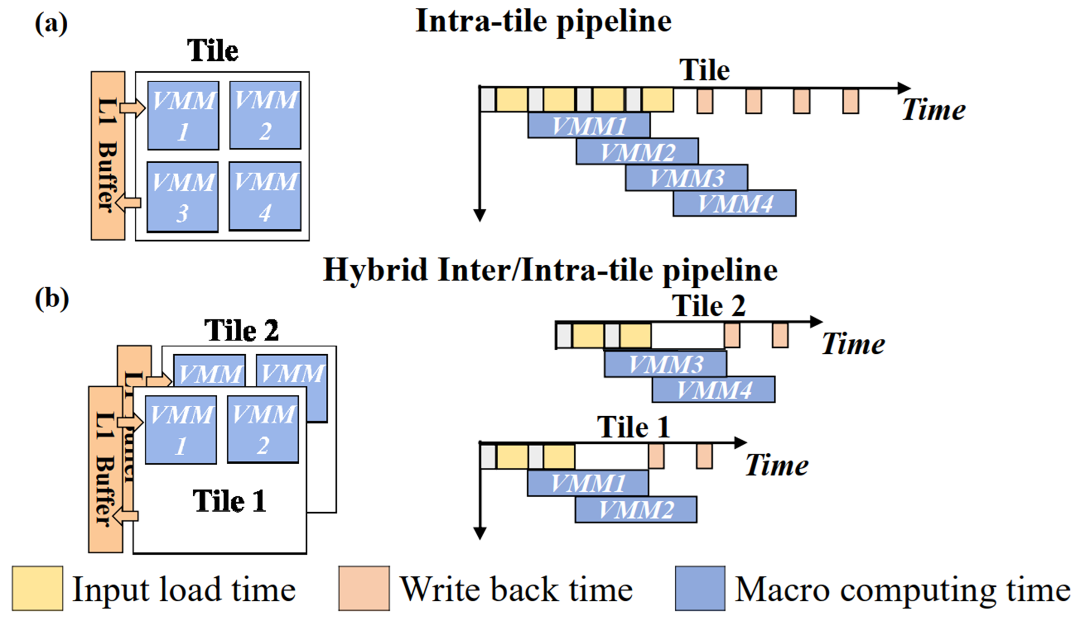
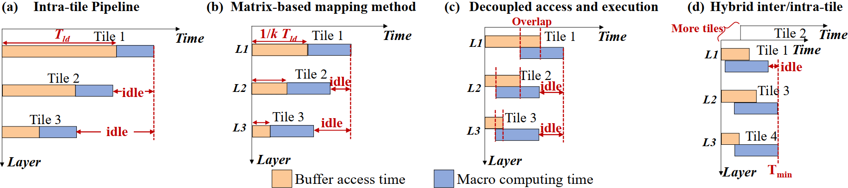
Could you please give an example for the size of shallow layer and deep layer?
ChatGPT said:
ChatGPT
Sure! Let's use an example where we are working with a Convolutional Neural Network (CNN) and look at the shallow and deep layers to understand how their sizes and computations differ.
Example: CNN with 3 Layers
Consider a CNN designed for image classification, where the input image is 32x32 pixels and has 3 channels (e.g., RGB). We'll use typical CNN architecture to explain the difference between shallow and deep layers.
Layer 1: Shallow Layer
Type: Convolutional Layer
Input size: 32x32x3 (3-channel image)
Filter size: 3x3 (small filter)
Number of filters: 16 (to extract 16 feature maps)
Here, this shallow layer will have fewer parameters because each filter is small (3x3), and there are fewer filters (16). The number of computations is frequent, meaning many operations are needed for each input image.
Number of parameters in this layer: Each 3x3 filter has 3x3x3 = 27 parameters (since there are 3 channels in the input image). With 16 filters, the total number of parameters is: 27×16=43227 \times 16 = 43227×16=432 parameters.
Output size: The output feature map size would be: (32 - 3 + 1) x (32 - 3 + 1) = 30x30 (since we use 3x3 filters with stride=1 and no padding).
So, the shallow layer has 16 feature maps of size 30x30, and it performs many operations to compute them.
Layer 2: Deep Layer
Type: Convolutional Layer
Input size: 30x30x16 (16 feature maps from Layer 1)
Filter size: 5x5 (larger filter than Layer 1)
Number of filters: 64 (to extract 64 feature maps)
Here, the deep layer has more filters (64) and larger filters (5x5), which means more parameters and a larger number of operations per filter. However, since this layer is deeper in the network, it computes sparsely, meaning it requires fewer operations overall compared to the shallow layer.
Number of parameters in this layer: Each 5x5 filter has 5x5x16 = 400 parameters (since there are 16 input channels). With 64 filters, the total number of parameters is: 400×64=25,600400 \times 64 = 25,600400×64=25,600 parameters.
Output size: The output feature map size would be: (30 - 5 + 1) x (30 - 5 + 1) = 26x26 (using 5x5 filters with stride=1 and no padding).
So, the deep layer has 64 feature maps of size 26x26, and while it has more parameters, it computes them less frequently than the shallow layer.
Comparison
Shallow layer: Fewer parameters (432) and frequent computation. It uses small filters (3x3) and works on the original image or the early stage feature maps.
Deep layer: More parameters (25,600) but less frequent computation. It uses larger filters (5x5) and works on more abstract features captured by previous layers.
Why this matters for hardware efficiency:
In the shallow layer, the number of computations is high because many small filters must process the data frequently, requiring the hardware to be engaged continuously.
In the deep layer, although there are more parameters and larger filters, the operations are fewer (sparser) because the input data has already been processed by the shallow layers. This means the hardware resources may remain idle for longer periods during the computations of the deep layers.
This difference in computation frequency between shallow and deep layers is why the hardware resources might be underutilized in deep layers, leading to inefficiencies in system throughput.
Yes, weights are loaded into the crossbars during CNN initialization. The "duplication" refers to ensuring that multiple crossbars (or PEs) within a tile each have a copy of the weights, enabling parallel and independent processing during intra-tile pipelines.This approach reduces memory contention and enables efficient, high-throughput computation.
Scenario:
Let's say you have a 3×3 kernel (weights) for a CNN layer.
You have 4 tiles, and each tile contains 8 PEs (crossbars).
Without Weight Duplication:
Each tile processes different regions of the input feature map (IFM), and only one copy of the weights is loaded in a single PE.
For parallel processing, each PE must wait to fetch weights, causing bottlenecks.
With Weight Duplication:
The same 3×3 weights are copied to all 8 PEs in each tile.
All 8 PEs can perform computations simultaneously for different parts of the IFM, greatly improving throughput.
Proposed Study
Previous Pipeline Design
Low throughput.
High latency due to dependent sequential operations.
Suffers from significant idle time between layers.
Duplicated Weights more tiles unit are active on different slices of IFM.
Layer Level Parallelism
Reduced computational delays.
Suffers from buffer access delays.
Suffers from cost.
Pipeline Optimization Design
Baseline
Notes:
This is raw pipeline approach, it suffers from the idle times in deep layers. It is actually about shallow layers takes longer time than deep layers. Because, shallow layers have small filters must process the data frequenctly.
Intra-tile pipeline is proposed over raw pipeline, it duplicates the weights and lets architecture to achieve more computation capability at the same time
Thus VMM operations results in shorter periods. More tiles are working It improves throupgput by reducing computational delays.
This increases the costs and this approach neglects buffer delays.
Traditional hardware accelerators waits on idle states for deep layers while waiting for shallow layers to finish.
The raw pipeline design performs parallel computation across CNN layers. However, due to the IFMs size of shallower layers being much bigger than that of deeper layers after several pooling operations, the raw pipeline is stuck by shallower layers, which spend more time for both buffer access and macro computation, as shown in Fig.3(a).
However, the buffer access of IFMs, OFMs, and partial sums, both load and write-back, are miss discussed.
Authors accepts the latest pipeline design called intra-tile as a baseline and propose collaborative approach.

Slide 7
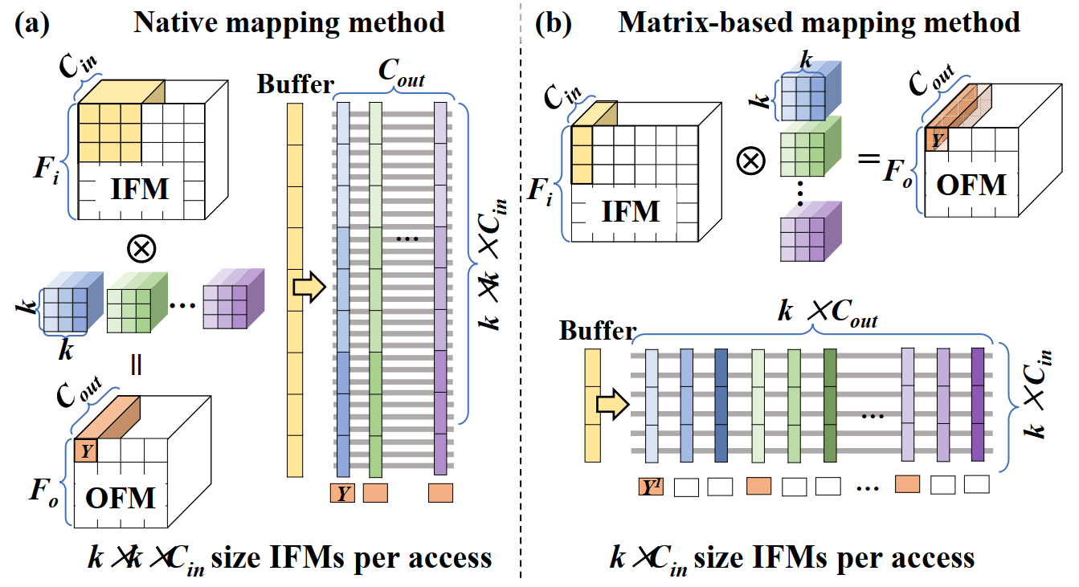
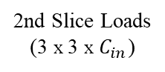
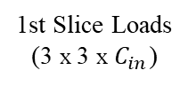
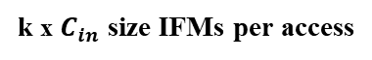
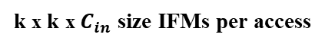
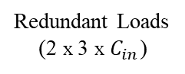
Proposed Study
Matrix-Based Mapping Method
1st Slice Loads
(3 x 3 x $C_{in}$)
Redundant Loads
(2 x 3 x $C_{in}$)
2nd Slice Loads
(3 x 3 x $C_{in}$)
Input
Sliding
Window
Input
Sliding
Window
Weight
Matrix
Weight
Matrix
k x k x $C_{in}$ size IFMs per access
k x $C_{in}$ size IFMs per access
Mapping in Raw & Intra-Tile Pipelines
Mapping in Proposed Pipeline
focus on access strategy instead of adding up additional computation units
Notes:
When mapping CNN models on CIM chips;
weights of the fully connected layer can be directly mapped to the crossbar (they don’t creates additional cost as we face through buffer retriavels)
multiple 3D kernels of the convolutional layer need to be unrolled to the 2D matrix,
3D IFM windows also need to be converted into 1D vector
Then the convolution can be implemented naturally with NVM crossbar.
Native Mapping
At each sliding cycle, size IFM data is loaded from buffers to use the IFM data. There is a repeated and redundant access here.
Matrix-Based Mapping
Rather than repeatedly accessed from buffers, a matrix-based weight mapping method is proposed.
Each 3D kernel is unrolled into the partial matrix and multiple 3D kernels are transformed into a whole matrix. At each sliding cycle, k×Cin size IFM data is loaded from buffers and input to the crossbar and calculations completed with lesser buffer access amounts.
Therefore, the matrix-based CNN mapping method reduces the loaded IFMs amount per convolution operation to 1/k times that of the native mapping method by reusing the loaded IFMs locally.

Slide 8
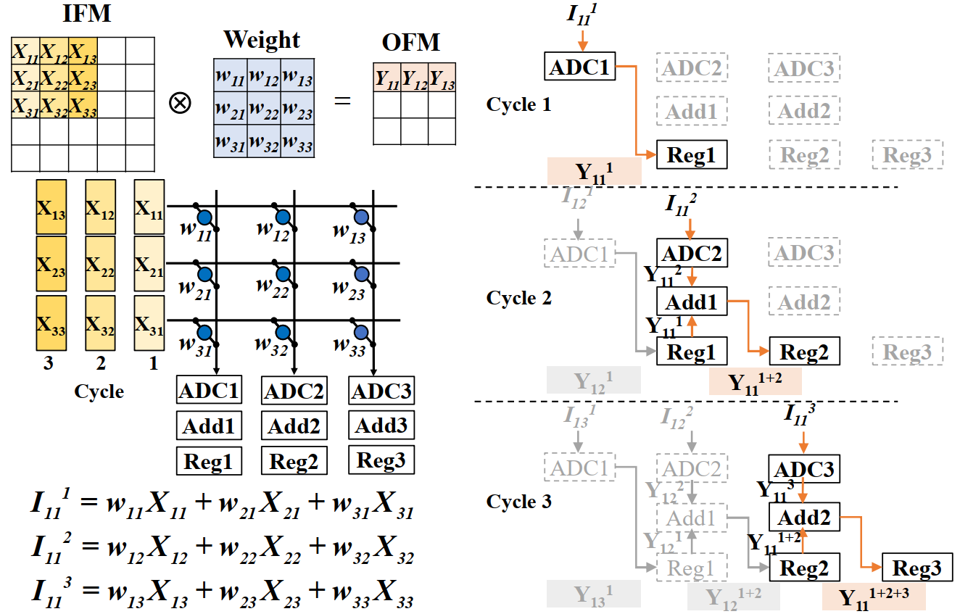
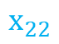
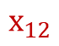
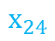
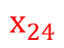
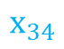
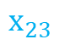
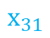
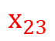
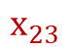
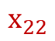
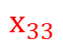
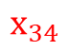
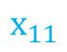
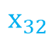
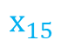
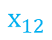
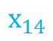
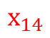

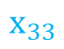
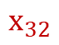
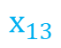
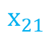
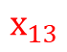

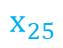
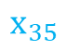
Proposed Study
Matrix-Based Mapping Method
Native Mapping
$$x_{13}$$
$$x_{12}$$
$$x_{11}$$
$$x_{23}$$
$$x_{22}$$
$$x_{21}$$
$$x_{33}$$
$$x_{32}$$
$$x_{31}$$
Cycle 1
$$x_{12}$$
$$x_{13}$$
$$x_{14}$$
$$x_{22}$$
$$x_{23}$$
$$x_{24}$$
$$x_{32}$$
$$x_{33}$$
$$x_{34}$$
Cycle 2
$$x_{13}$$
$$x_{14}$$
$$x_{15}$$
$$x_{23}$$
$$x_{24}$$
$$x_{25}$$
$$x_{33}$$
$$x_{34}$$
$$x_{35}$$
Cycle 3
Notes:
This figure is important to understand interaction between data and CIM Chips.
This is the hardware implementation for the matrix-based mapping method.
Assume kernel size is 3×3 and only the one output is calculated.
Weight matrixes are loaded into crossbar during initialization.
In fact, in each sliding cycle, k×Cout size OFMs are obtained simultaneously.
Convolution operation flow does not effected as we seen and still achieve robust results, but we should not need repeated access to IFM on buffer.
At sliding cycle 1, NVM crossbar and then perform multiplication and accumulation (MAC) with weights.
The output current is converted by ADC1 and digital output is stored in Reg1.
Partial sums achieved in Cycle 2 and Cycle 3 creates results.

Slide 9
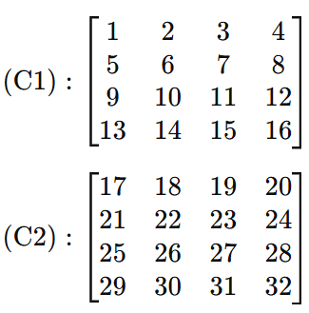
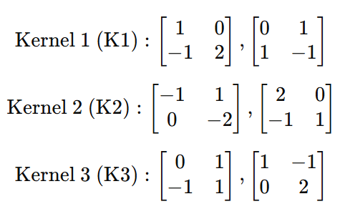
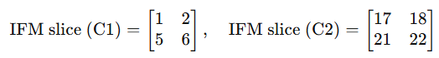


Proposed Study
Matrix-Based Mapping Method
IFM Size: | 4x4x2
Kernel Size: | 2x2
Number of Kernels: | 3
Sliding Window: | Stride 1
Native Mapping Method
Each sliding 2×2×2 IFM slice is loaded once per kernel
Matrix-Based Method
Each sliding 2×2×2 IFM slice is loaded once per sliding window
Kernel 1: 2x2x2 loads
Repeat for Kernel 2-3
1 Slice: 24 loads
9 Slice: 216 loads
Kernel 1: 2x2x2 loads
Reuse for Kernel 2-3
1 Slice: 8 loads
9 Slice: 72 loads
1/k
Access
Notes:
This is the detailed math corresponding of achieved buffer access amounts over a simple example.
This approach contributes a to reduce buffer cost.
I just want to see how the proposed part is works.

Slide 10








Proposed Study
Decoupled Access and Execution
SAE
DAE
SAE
$$T_{total}=\left(\left(T_{load}+ T_{write}\right)∙{ N}_{p}+ T_{exe}\right)∙M$$
Computation Dominates [$T_{exe}>T_{load}+ T_{write}]$
$$\left(M−1\right)∙\left(N_{p}−1\right)∙\left( T_{load}+ T_{write}\right)$$
DAE - CD
$$T_{total}=\left(T_{exe}+ T_{load}+ T_{write}\right)∙M+\left( T_{load}+ T_{write}\right)∙(N_{p}−1)$$
$R$ =
BufferAccess Dominates [$T_{load}+T_{write}>T_{exe}]$
$$T_{exe}∙M−\left(N_{p}−1\right)∙\left( T_{load}+ T_{write}\right)$$
DAE - BD
$$T_{total}=\left(T_{load}+ T_{write}\right)∙(N_{p}∙M+N_{p}−1)$$
$R$ =
focus on instruction flow to reduce single layer latency by hiding buffer acces under computation
SAE
Latency Reduction
DAE-DC
DAE-DB
Notes:
In the tradional architecture, buffers only perform read OR write operations at the same time because of limited buffer bandwidth and control complexity.
In nvCIM accelerators, the time sequence for SAE;
First, loading input data from the buffer to CIM macro,
Secondly, computing convolution,
Finally, writing the output back into the buffer,
Advantages of SAE
Simple implementation with sequential data loading, computation, and write-back steps.
Low hardware complexity (no need for complex scheduling).
Disadvantages of SAE
High latency due to non-overlapping operations (one stage must finish before the next starts).
Idle periods in memory or computation units, leading to poor resource utilization.
In this study, DAE design is proposed for nvCIM accelerators, which reduces the single-layer latency by allowing buffer access and computation to overlap in time, as shown.
They analyze the reduced latency when the macro computation delay is longer than or shorter than the total buffer access delay, respectively.
If the computation delay is longer than the total buffer access delay, the computation delay will dominate total latency.
If the computation delay is shorter than the total buffer access delay, the buffer access delay will domiante total latency.
The total latency of Np CIM macros for M convolution cycles can be calculated as formula

Slide 11














SAE
$$T_{total}=\left(\left(T_{load}+ T_{write}\right)∙{ N}_{p}+ T_{exe}\right)∙M$$
$$Latency Reductions$$
Computation Dominates [$T_{exe}>T_{load}+ T_{write}]$
$$\left(M−1\right)∙\left(N_{p}−1\right)∙\left( T_{load}+ T_{write}\right)$$
DAE - CD
$$T_{total}=\left(T_{exe}+ T_{load}+ T_{write}\right)∙M+\left( T_{load}+ T_{write}\right)∙(N_{p}−1)$$
BufferAccess Dominates [$T_{load}+T_{write}>T_{exe}]$
$$T_{exe}∙M−\left(N_{p}−1\right)∙\left( T_{load}+ T_{write}\right)$$
DAE - BD
$$T_{total}=\left(T_{load}+ T_{write}\right)∙(N_{p}∙M+N_{p}−1)$$
Proposed Study
Decoupled Access and Execution
Parameter | Number | Description
$$T_{load}$$ | 2 | Input Load Time
$$T_{write}$$ | 1 | Output WB Time
$$T_{exe}$$ | 5 | Macro Execution Time
$$N_{p}$$ | 4 | Number of Parallel CIM Macro
$$M_{}$$ | 8 | Number of Convolution Cycles
SAE
DAE - CD
DAE - BD
$$T_{total}=\left(\left(T_{load}+ T_{write}\right)∙{ N}_{p}+ T_{exe}\right)∙M$$
$$T_{total}=\left(T_{exe}+ T_{load}+ T_{write}\right)∙M+\left( T_{load}+ T_{write}\right)∙(N_{p}−1)$$
$$T_{total}=\left(T_{load}+ T_{write}\right)∙(N_{p}∙M+N_{p}−1)$$
$$T_{total}=\left(\left(2+1\right)∙4+5\right)∙8$$
$$T_{total}=\left(5+2+1\right)∙8+\left( 2+1\right)∙(4−1)$$
$$T_{total}=\left(2+1\right)∙(4∙8+4−1)$$
$$T_{total}=136$$
$$T_{total}=73$$
$$T_{total}=105$$
$$Formula$$ | Description | Result (Time Units)
$$1$$ | Serial Execution (no overlap) | 136
$$2$$ | DA Execution Dominated (partial overlap) | 73
$$3$$ | DA Access Dominated (partial overlap) | 105
$$Case$$ | Formula | Reduction (Time Units)
Serial Execution (no overlap) | N/A | N/A
$$\text{DA} \text{Execution} \text{Dominated}$$ $$\text{(}\text{partial} \text{overlap}\text{)}$$ | $$\left(M−1\right)∙\left(N_{p}−1\right)∙\left( T_{load}+ T_{write}\right)$$ | 63
$$\text{DA} \text{Access} \text{Dominated}$$ $$\text{(}\text{partial} \text{overlap}\text{)}$$ | $$T_{exe}∙M−\left(N_{p}−1\right)∙\left( T_{load}+ T_{write}\right)$$ | 31
Notes:
This is the detailed math corresponding of achieved reductions over a simple example.
This approach contributes a lot to reduce total latency.
I just want to see how the proposed part is works.
T total = total latency for Np during M convolution cycles

Slide 12

Proposed Study
Hybrid Inter/Intra Tile
$$T_{overlap}$$
-
Reduced Latency
Area Cost
Notes:
a) multiple duplicated weights can be computed at the same time, the IFMs and OFMs need to be loaded from and written back to buffers sequentially.
a) Therefore, the intra-tile pipeline still suffers from unbalanced challenges from non-negligible buffer access delay.
Solution to the above problem is mapping weight duplications into independent tiles. Thus, the CNN operational latency will reduce.
b) Each tile handles only its assigned portion of the IFMs, simultaneously.
b) H-IT design combines throughput and area cost is proposed to balance the overall latency among different CNN layers.
b) Assigning weight duplications of bottleneck layers over multiple tiles reduces the buffer access amount of a single tile, which in turn reduces the latency of bottleneck layers.
b) There is a tradeoff between WD and TN: More weight duplications in a single tile would increase the tile latency and more tile numbers would increase area
WD: Weight Duplications
TN: Tile Numbers

Slide 13
Proposed Study
Pipeline Optimization Design Summary
Baseline
First to speed up computation of bottleneck layers.
Suffers from unbalanced problems when taking buffer access delay into account.
Requires weight duplication across PEs, increasing memory
Minimizes buffer access delays reusing IFM slices
Reduces redundant data movement
Leverages local reuse of weights and inputs
Enables overlapping of load, compute, and write-back.
Reduce total latency.
Hides memory access under computation cycles.
Scales better than serial methods for deeper CNNs and large IFMs.
HW/SW complexity increases due to schedule and coordinate parallel stages.
Balanced workload across tiles (inter-tile) and within tiles (intra-tile)
Preventing Bottlenecks
Reduce Idle States
High Throughput
Suitable for Deep CNN with many layers and large feature maps
May require complex scheduling to synchronize tile operations
Hardware cost increases due to managing-tile communication.
Notes:
Abstract
In this work, from the perspective of the whole system, we propose a high-performance NVM-based CNN accelerator with a balanced pipeline, which both takes account of the CIM macro computing delay and buffer access delay.
Intra-tile pipeline can effectively improve the throughput of CNN accelerators, but it suffers from unbalanced problems when taking buffer access delay into account.
On the basis of the intra-tile pipeline, we propose a high-performance NVM-based CNN accelerator with a balanced pipeline design.
Reduce - CIM Macro Computing Latency
Reduce - Buffer Access Latency
First, a matrix-based CNN mapping method is proposed to release the repeated access of IFMs.
Second, decoupled access and execution is introduced to reduce the single-layer latency by overlapping access and computation in time.
Third, a hybrid inter/intra-tile pipeline design is designed to balance the overall latency across CNN layers by assigning computing tasks of the bottleneck layer to multiple tiles.

Slide 14

Proposed Study
Operator Level
Purpose: Optimize data mapping and reuse for matrix to minimize buffer access.
Key Optimization: Matrix-based weight mapping reduces redundant IFM loading and maximizes local reuse of data slices.
2. Macro Level
Purpose: Latency optimization of a CIM macro for (L/W & Compute)
Key Optimization: Decoupled access and execution, overlap memory access with computation to hide access delays under execution.
3. System Level
Purpose: Balancing workload, multiple tiles to avoid bottlenecks
Key Optimization: Hybrid inter/intra-tile pipeline
Coordinate execution within a tile (intra-tile parallelism)
Coordinate execution across tiles (inter-tile pipeline)
Min Total Latency * Area Cost for Layer i
Notes:
This scheme is designed to balance the workload across the various levels of the accelerator (operator, macro, and system levels).
It minimize bottlenecks and achieving high throughput.
Matrix-Based Weight Mapping (Operator Level):
Aims to reduce the buffer access delay by efficiently reusing Input Feature Maps (IFMs).
Instead of reloading the same IFM slice for each convolution kernel, the slice is loaded once and reused for all kernels.
This reduces redundant data movements and speeds up convolution operations.
Decoupled Access and Execution Design (Macro Level):
Allows overlapping of data loading, computation, and write-back operations.
Access (load/write) and execution (computation) are decoupled, enabling parallel operations within a convolution layer.
This reduces single-layer latency by hiding data transfer delays under computation.
Hybrid Inter/Intra-Tile Design (System Level):
Balances the latency across different CNN layers by adopting a hybrid processing approach:
Inter-tile pipeline: Each tile handles different layers of the CNN sequentially.
Intra-tile pipeline: Within a single tile, multiple Processing Elements (PEs) process different portions of the same layer in parallel.

Slide 15


Evaluation
ResNet-18
Hardware
Complexity
Notes:
As we said it is too important to reduce latency in the shallow layers. Because they have larger input feature map and smaller Kernel size. Biggest bottleNECK for our flow.
Each systematic step gradually applied and compared the effects for ResNet18.
Fig 1. The proposed study reduce latency in important manner for all CNN layers.
Meanwhile, less amount of buffer access can also save buffer access energy.
Study also reduce idle period as we move to hybrid tile.
Fig 2. We have also latency x area graphic to see trade-off result between latency and area.
The area overhead is slightly increased. And no additional cost.

Slide 16


Evaluation
Notes:
Study hows matrix-based mapping method can save 14% energy consumption for the ImageNet recognition task.
The proposed study does not claim that better improvements over literature but claims that lirature studies
These architectures:
Execute CNN layers in a parallel raw pipeline or intra-tile pipeline approach.
Do not address layer-level imbalances (shallow layers dominate execution time).
Use static weight duplication, resulting in higher area cost.

Slide 17
Key Achievements and Contributions
The study provides solutions to:
Latency bottlenecks due to sequential data access.
Redundant data loading and poor data reuse.
Imbalanced workloads across CIM macros.
Scalability issues with large CNN models.
Key achievements by study:
Reduced Pipeline Latency: Faster processing by minimizing idle time and bottlenecks.
Improved Throughput: Higher number of inputs processed per second.
Energy Efficiency: Reduction in memory access overheads lowers power consumption.
Hardware Scalability: The method is adaptable to various hardware accelerators with different configurations (e.g., buffer size, number of cores).
Experiments shows that proposed pipeline achieves 3.7x, 7.5x and 3.5x througput (ResNet18,VGG19, and ResNet34) over basepipelines
Notes:
They strongly analized the detailed workflow of CNN and proposed an pioneering accelerator design.

Slide 18

The well-balanced pipeline scheme described in Section 3.5 of the paper refers to an optimized architecture and operational flow for the proposed nvCIM accelerator. This scheme is designed to balance the workload across the various levels of the accelerator (operator, macro, and system levels), minimizing bottlenecks and achieving high throughput with low hardware cost.
Here’s what it entails:
Key Components of the Well-Balanced Pipeline
Matrix-Based Weight Mapping (Operator Level):
Aims to reduce the buffer access delay by efficiently reusing Input Feature Maps (IFMs).
Instead of reloading the same IFM slice for each convolution kernel, the slice is loaded once and reused for all kernels.
This reduces redundant data movements and speeds up convolution operations.
Decoupled Access and Execution Design (Macro Level):
Allows overlapping of data loading, computation, and write-back operations.
Access (load/write) and execution (computation) are decoupled, enabling parallel operations within a convolution layer.
This reduces single-layer latency by hiding data transfer delays under computation.
Hybrid Inter/Intra-Tile Design (System Level):
Balances the latency across different CNN layers by adopting a hybrid processing approach:
Inter-tile pipeline: Each tile handles different layers of the CNN sequentially.
Intra-tile pipeline: Within a single tile, multiple Processing Elements (PEs) process different portions of the same layer in parallel.
What Does the Well-Balanced Pipeline Achieve?
The pipeline scheme ensures that all levels of the accelerator—operator, macro, and system—work together efficiently to:
Minimize Latency Across Layers:
The inter/intra-tile hybrid design ensures balanced processing time across layers of the CNN, preventing any single layer from becoming a bottleneck.
Optimize Resource Utilization:
By reusing IFMs and overlapping access and execution, the pipeline maximizes the use of available memory, compute resources, and data bandwidth.
Reduce Hardware Cost:
The matrix-based mapping and hybrid tiling approaches allow for efficient weight duplication and buffer usage, reducing the overall hardware complexity.
Increase Throughput:
With minimized redundant operations and decoupled dataflow, the pipeline achieves high throughput even for deep CNNs.
Illustrative Example (Key Flow)
For a CNN with multiple layers:
Layer 1 (L1):
IFMs are loaded into Tile 1 (inter-tile pipeline).
Multiple PEs within the tile process different parts of the IFM simultaneously (intra-tile pipeline).
OFMs are generated and written back.
Layer 2 (L2):
While Tile 1 processes Layer 2, Tile 2 may start processing Layer 3, enabling inter-layer parallelism.
Hybrid Execution:
For deeper layers, inter/intra-tile cooperation ensures that all tiles remain balanced, preventing latency buildup in any one part of the system.
Benefits Declared in the Paper
The paper claims that the well-balanced pipeline achieves:
3.7x throughput improvement for ImageNet inference with ResNet18.
7.5x throughput improvement for VGG19.
3.5x throughput improvement for ResNet34.
These results validate the design’s ability to handle various CNN architectures effectively while maintaining efficiency and scalability.
In essence, the well-balanced pipeline scheme is a holistic design optimization that coordinates at all levels (operator, macro, and system) to achieve high throughput and low latency with minimal resource overhead. It’s a critical part of the proposed nvCIM accelerator’s success in CNN acceleration.
The well-balanced pipeline scheme discussed in Section 3.5 of the paper refers to a carefully designed execution framework that optimizes the balance between computation and memory access latency across different levels of the architecture. This scheme integrates the optimizations proposed at the operator, macro, and system levels to improve throughput while minimizing hardware costs.
Let me break it down step by step:
Key Components of the Well-Balanced Pipeline
1. Operator-Level Optimization
Technique: Matrix-based weight mapping
Goal: Reduce the frequency of buffer access by reusing input feature map (IFM) slices across all convolution kernels.
Impact:
By loading an IFM slice only once and reusing it for all kernels, the number of memory accesses is significantly reduced.
This contributes to a well-balanced pipeline by optimizing the data access latency, ensuring the compute units remain active for longer periods.
2. Macro-Level Optimization
Technique: Decoupled access and execution
Goal: Overlap data loading (access) and computation (execution) stages to reduce idle time for hardware resources.
Impact:
Instead of handling load, compute, and write-back operations sequentially (as in serial pipelines), these operations are performed in parallel:
While one chunk of data is being computed, the next chunk is preloaded into the buffer.
This pipeline minimizes idle cycles, balancing data access with computation latency.
3. System-Level Optimization
Technique: Hybrid inter-/intra-tile design
Goal: Balance latency across different tiles and layers of the CNN to avoid bottlenecks.
Impact:
At the intra-tile level:
Multiple processing elements (PEs) within a tile operate on different IFM slices in parallel.
Weight duplication ensures efficient utilization of PEs without contention.
At the inter-tile level:
Tiles are coordinated to avoid idle time between tiles processing consecutive layers.
The output feature maps (OFMs) of one tile are efficiently passed as input feature maps (IFMs) to the next tile.
How the Scheme Balances the Pipeline
Reduces Data Access Latency:
Matrix-based mapping reduces redundant buffer loads, ensuring data access does not become a bottleneck.
Hides Access Delays:
Decoupled access and execution overlaps memory access with computation, minimizing delays caused by data transfer.
Maintains Uniform Latency Across CNN Layers:
The hybrid inter-/intra-tile scheme ensures all tiles complete their processing stages with minimal disparity, avoiding imbalance across layers.
Performance Improvement
The scheme ensures that:
Each layer of the CNN is processed efficiently without hardware underutilization.
The latency contribution of data movement is minimized relative to computation.
Resources are better utilized, improving overall throughput.
Real-World Impact
In the paper, this well-balanced pipeline design leads to:
3.7× throughput improvement for ResNet-18.
7.5× throughput improvement for VGG-19.
3.5× throughput improvement for ResNet-34.
These improvements stem from the synergy of operator-, macro-, and system-level optimizations that align the computational and memory access latencies.
Team work
Questions
Notes:
Thank you so much for listening me. I am glad to answer if any question.

